Slide 1





PRESENTATION 2026
Project Title- A Comprehensive Educational Analytics System for Evaluating Teaching Performance via Student Feedback
Mentor Name
Faculty Email
Faculty Name
UmaMaheshwari
vartikamishra2018@gmail.com
Vartika Mishra

Slide 2

Outline
Abstract of the Project
Problem Statement
Proposed Solution
System Architecture
Live Demo of the Project
Embedded Video of Project
Conclusion
Future Scope

Slide 3
Abstract
AICW Fellowship project analyzing student feedback using AI and data visualization
Objective: Evaluate teaching effectiveness and improve course quality
Tools: Excel, Microsoft Copilot, Chatbot
Outcome: Data-driven insights for better academic decisions
Highlight: Integration of AI with interactive dashboards for real-world analysis

Slide 4

Student feedback is often unstructured and difficult to analyze effectively
Manual analysis limits extraction of meaningful insights on teaching performance
Lack of AI tools for sentiment analysis and automated summarization
Affects educational institutions, faculty, and decision-makers
Existing systems lack interactive visualization and real-time insights
Scope: Develop an AI-based system to analyze feedback and generate actionable insights
Problem Statement

Slide 5

Proposed Solution
Develop an AI-assisted educational analytics system to process student feedback
Convert raw and unstructured data into structured, meaningful insights
Key Components:
Data cleaning & preprocessing using Excel / Power BI
Analytical modeling to evaluate teaching performance
AI integration (Microsoft Copilot & Chatbot) for:
Sentiment analysis
Automated summarization
Insight generation
Output:
Interactive Excel dashboards
Clear visualization of feedback trends
AI-generated recommendations for teaching improvement
Result:
Faster, accurate, and data-driven academic decision-making
Improved teaching quality and student satisfaction

Slide 6
System Architecture
Data Input / Source
Processing / Analysis
Student feedback dataset (CSV/Excel)
1000+ responses from students
Ratings on teaching & course parameters (1–10 scale)
Collected from institutional feedback system
Data Cleaning: Removed duplicates, standardized formats, validated data using Excel/Power BI
Data Transformation: Structured dataset, corrected data types, prepared for analysis
Analysis: Calculated averages, trends, and performance indicators using Excel & Power BI
AI / Tool Integration
Output / Dashboard
AI Processing: Used Microsoft Copilot & chatbot for summarization and insight generation
Outcome: Converted raw data into meaningful, actionable insights in form of Dashboard.

Slide 7
Live Demo of Project

Slide 8
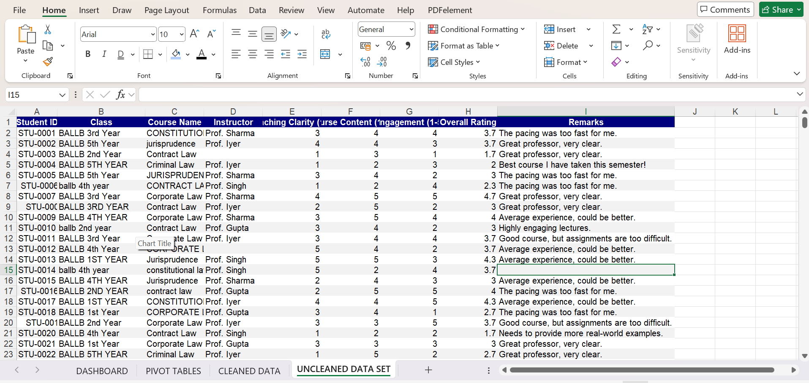
Raw Data Set

Slide 9
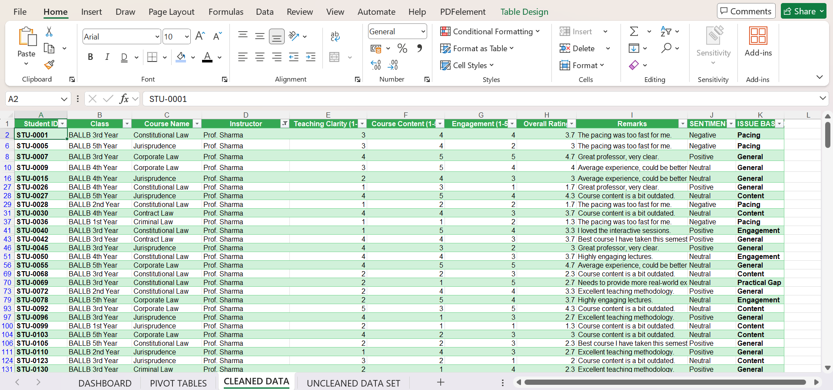
Cleaned Data Set

Slide 10
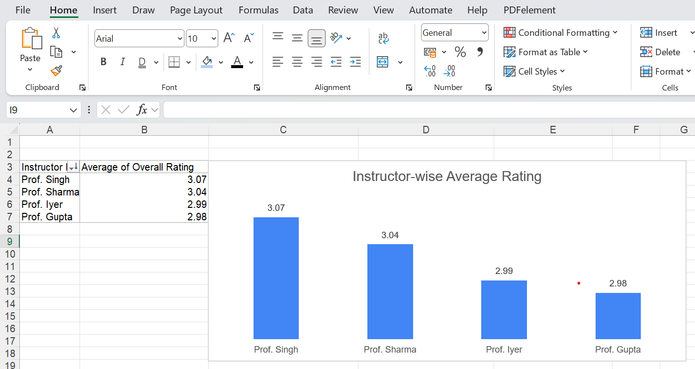
Average Ratings by Instructor

Slide 11
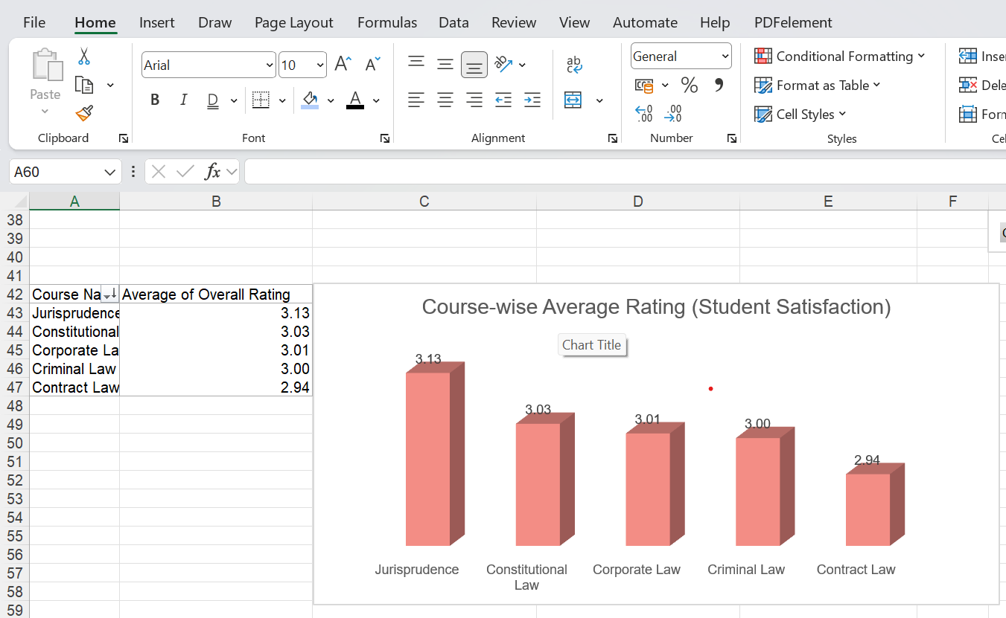
Course-wise Average Rating (Student Satisfaction)

Slide 12
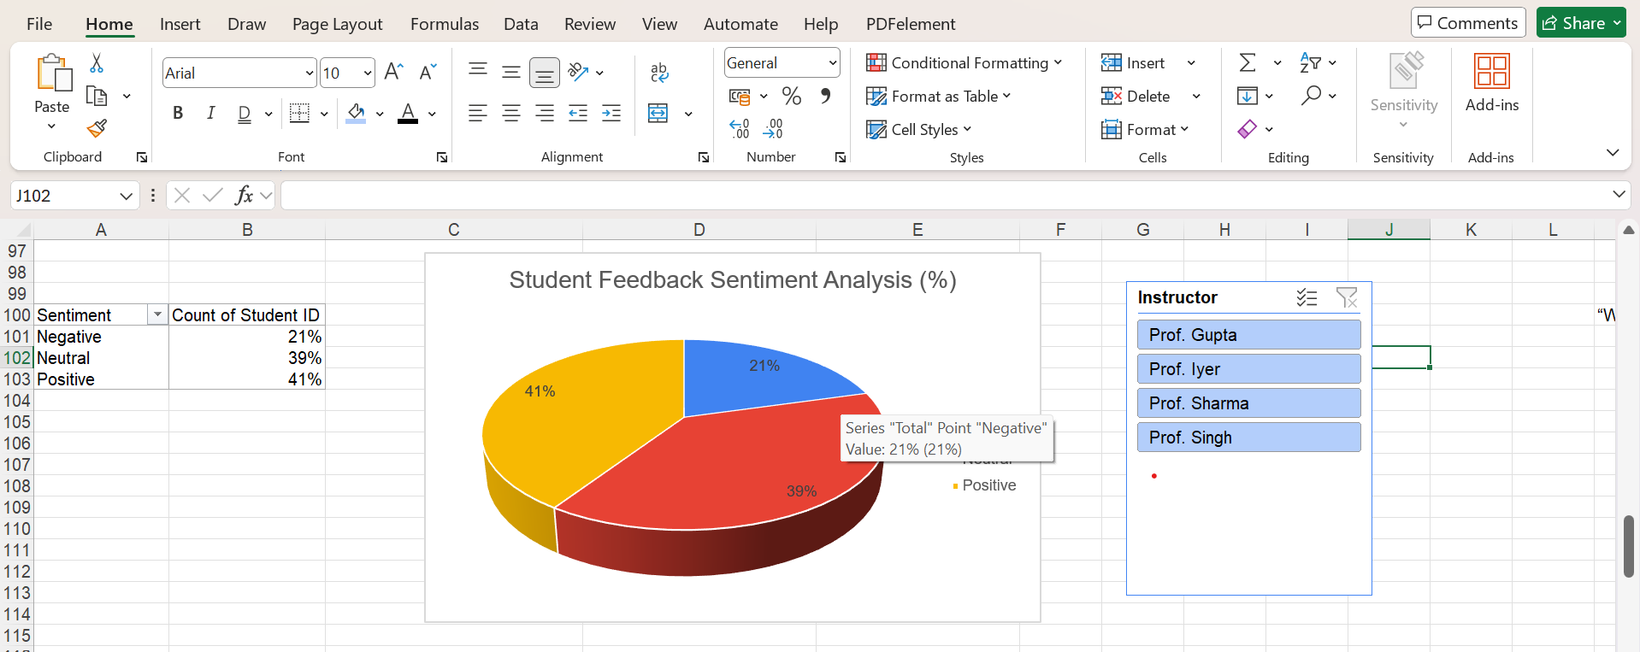
Instructor-Wise Sentiment Breakdown Pie-chart

Slide 13
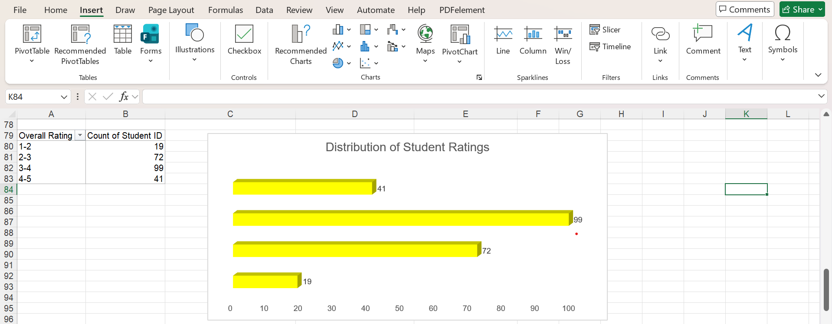
Overall Rating Distribution column chart

Slide 14
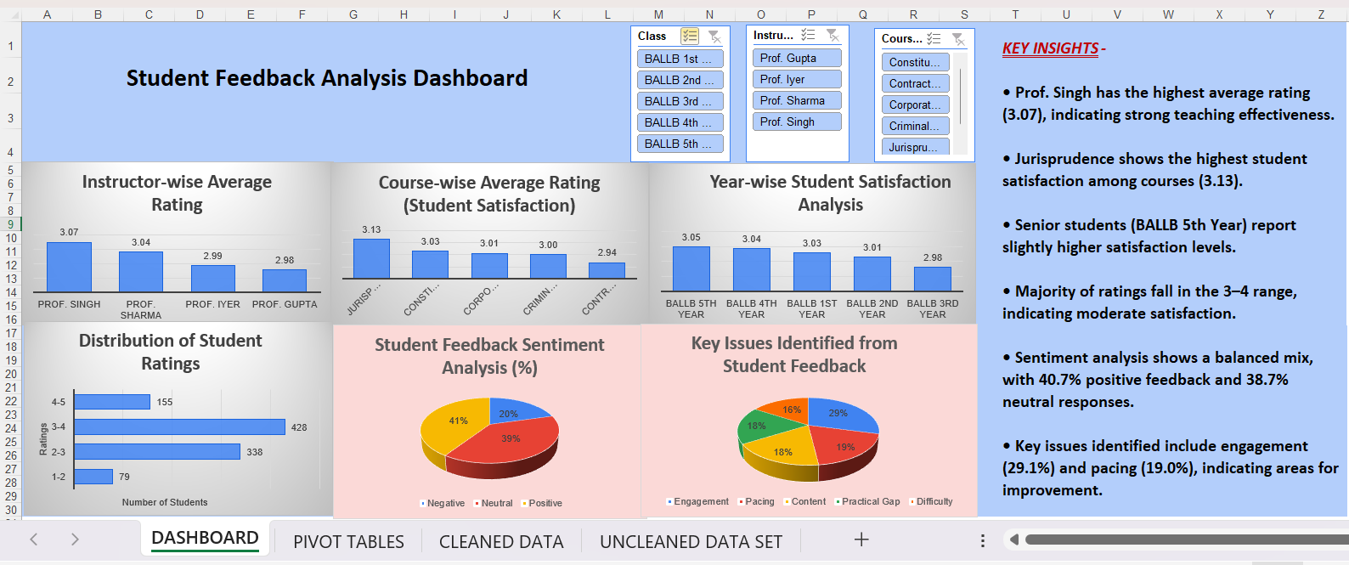
Interactive Dashboard

Slide 15
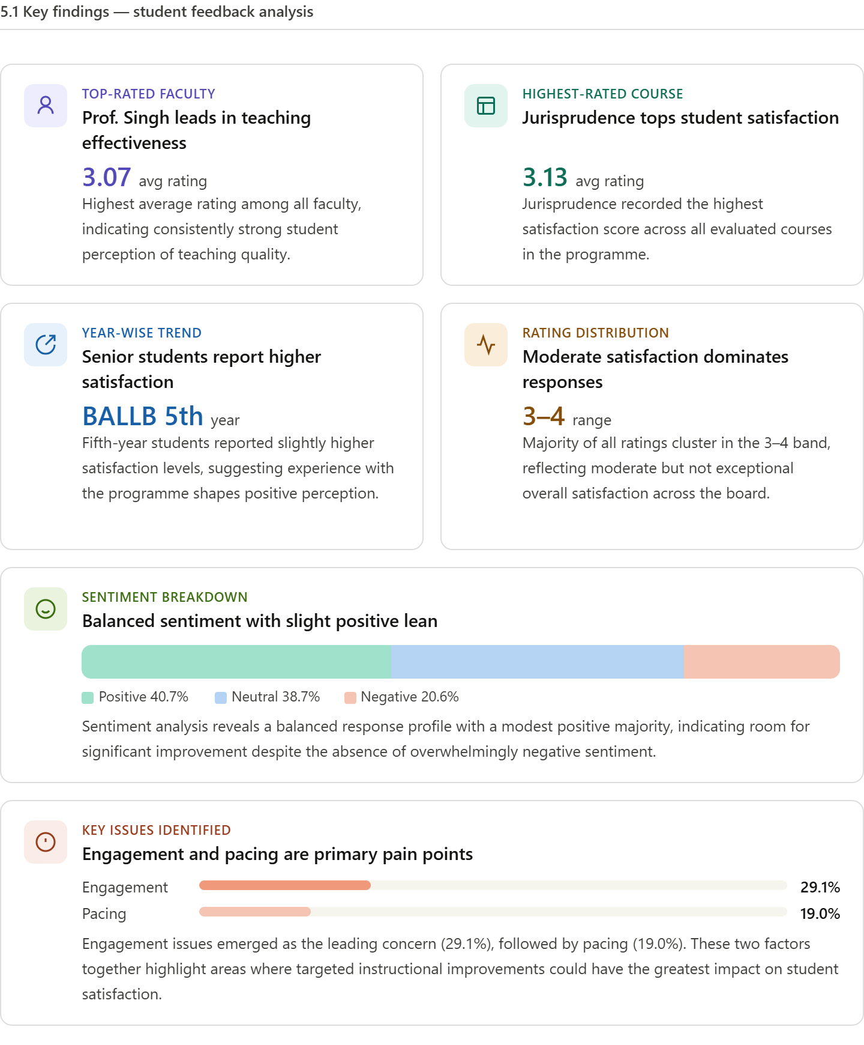
Key Findings

Slide 16
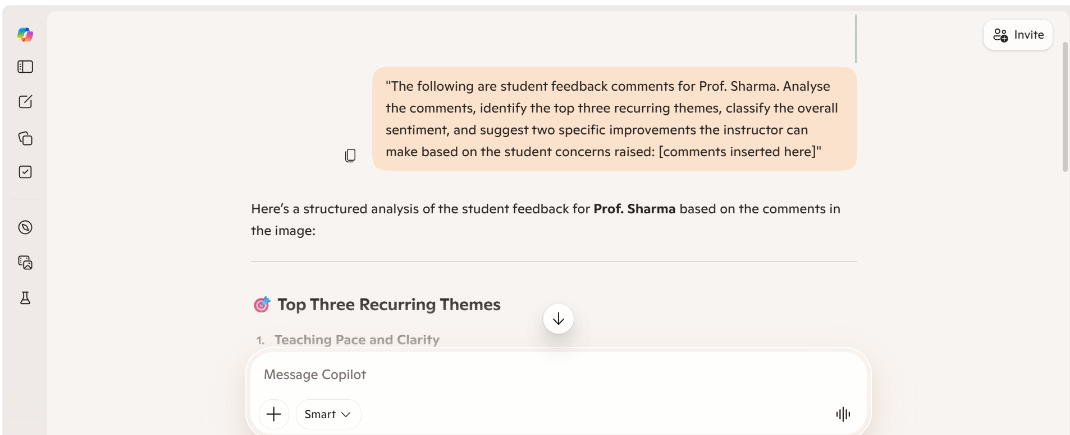
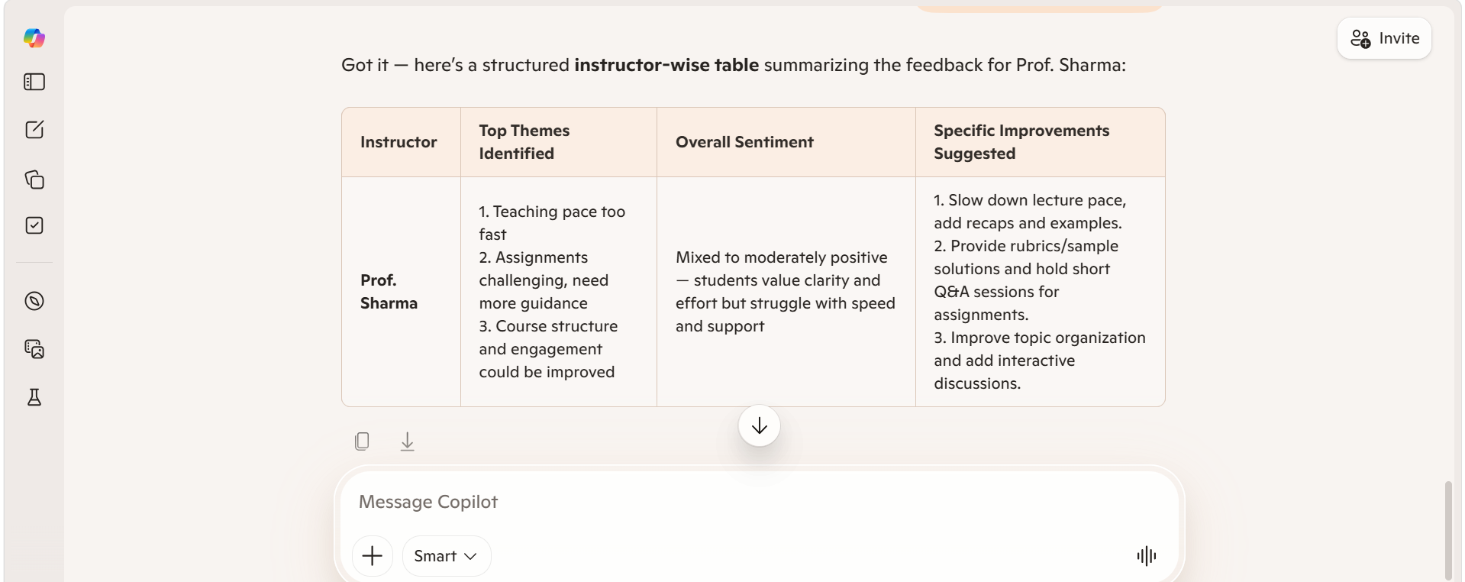
Microsoft Copilot Feedback Analysis

Slide 17
Video of Project Demo
[https://your-project-demo-link.com]
vartikamishrastudy/Evaluating-Teaching-Performance-via-Student-Feedback: A Comprehensive Educational Analytics System for Evaluating Teaching Performance via Student Feedback

Slide 18
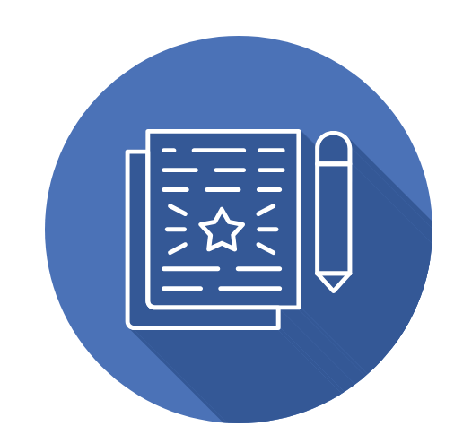
Conclusion
Successfully developed an AI-assisted system to analyze student feedback
Converted raw data into clear insights using Excel, Power BI, and AI tools
Key findings showed strong teaching performance with areas for improvement in assignments and support
All project objectives were successfully achieved
Enabled data-driven decision-making for academic improvement
Adds value by integrating AI with educational analytics for better teaching and learning outcomes
CONCLUSION

Slide 19

Future Scope
Integration of real-time data collection systems for continuous feedback analysis
Inclusion of text-based feedback & advanced sentiment analysis (NLP)
Development of predictive models for student satisfaction and teaching performance
Deployment as a web/mobile application for wider accessibility
Integration with LMS platforms (like Moodle, Google Classroom)
Use of advanced AI models for deeper insights and recommendations
Expansion to multi-institution datasets for scalability and broader analysis

Slide 20
Thank You
AICW Fellowship | Student Project Presentation 2026
LinkedIn | Edunet Foundation

